Slide 1
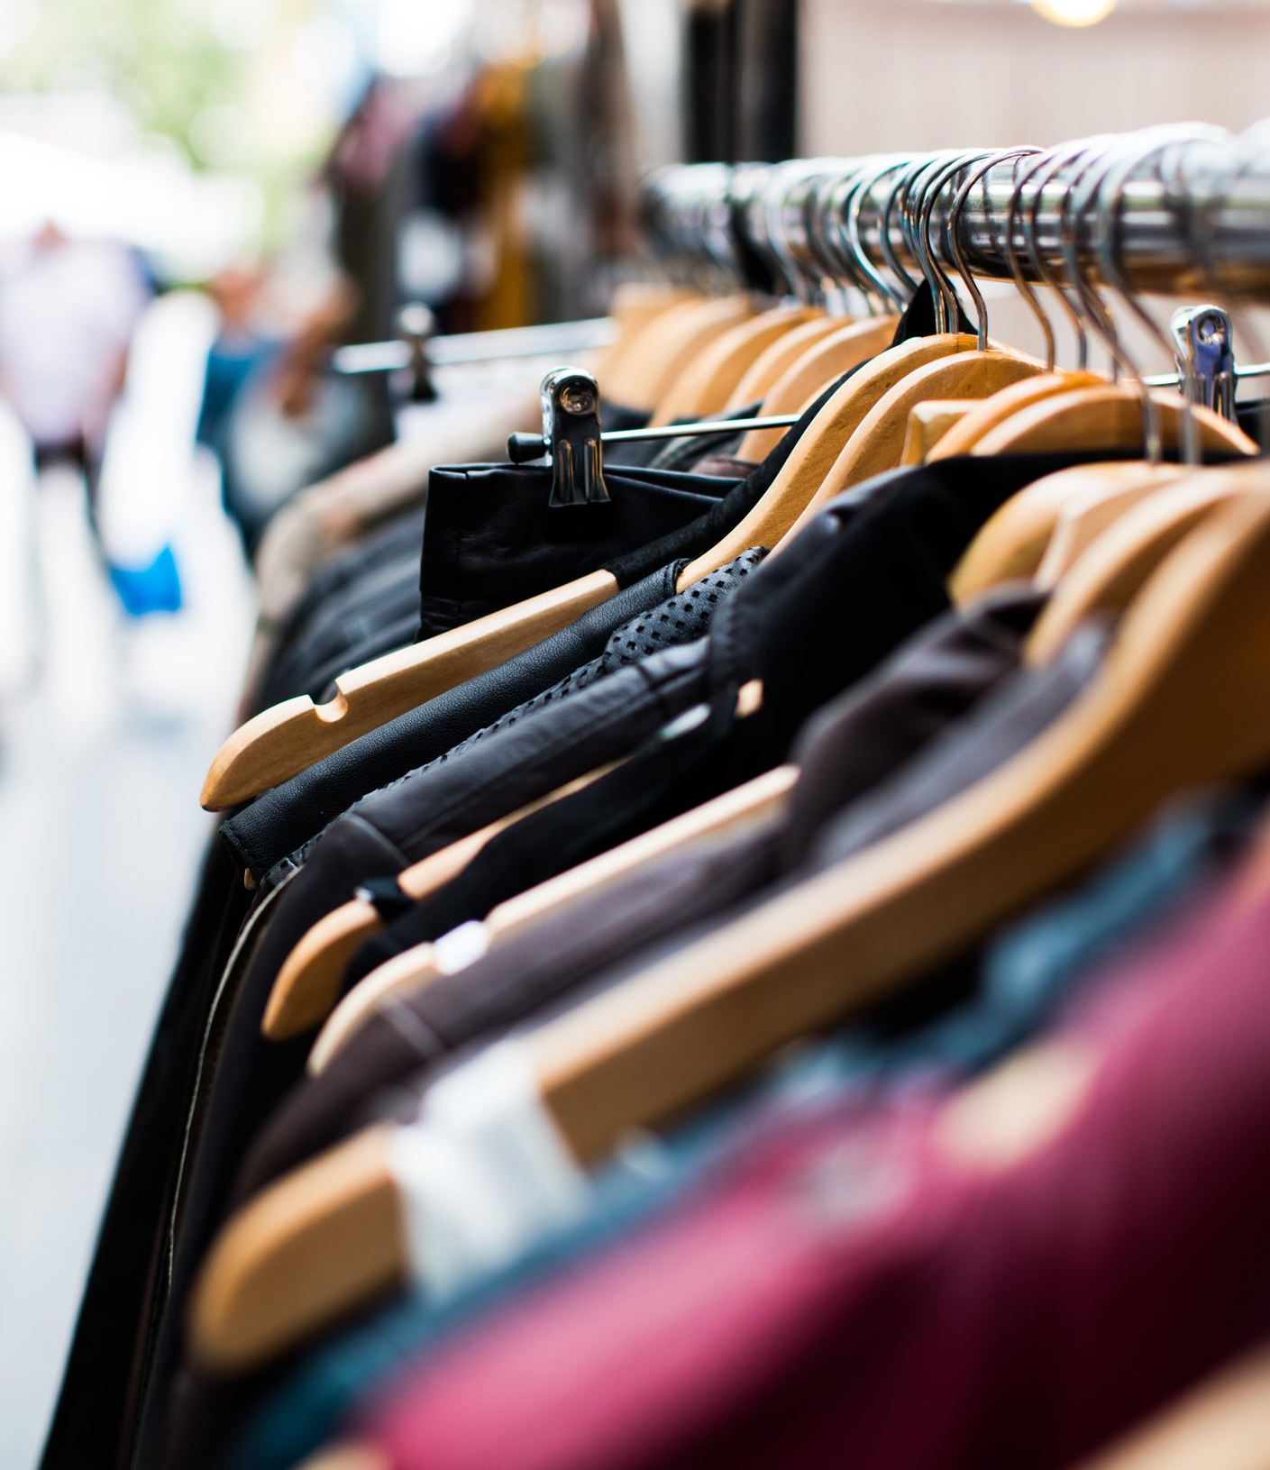
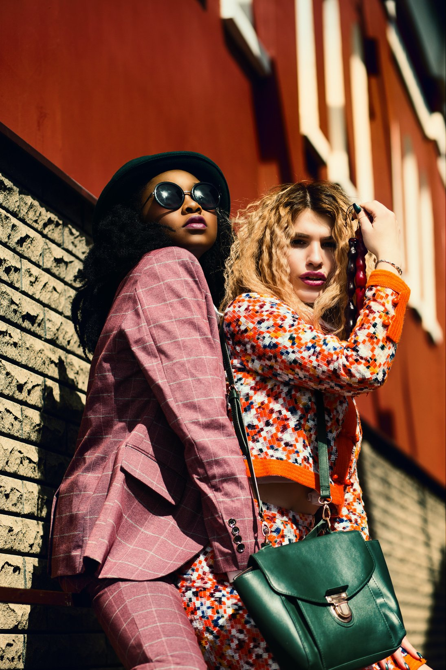
Analyzing women’s
E-commerce clothing
reviews
WHERE LUXURY MEETS SUSTAINABILITY
By: Ruqaiah Abdullah
Rawan Alshehri
Alanoud Alzahrani

Slide 2
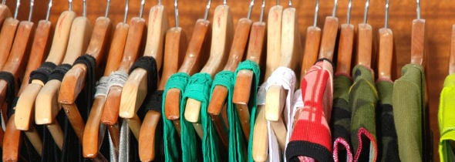
Outline
-Introduction
-Dataset
-Mythology
-Results and Analysis
-Conclusion

Slide 3

Introduction
in this project, we'll be using NLP with Topic Modeling and Clustering to find out some good information about customers reviews to take advantage of e-commerce
answering some questions:
What is the best selling clothing?
What is the most type of clothes that has more positive reviews?
At which age womens buy clothes most?

Slide 4
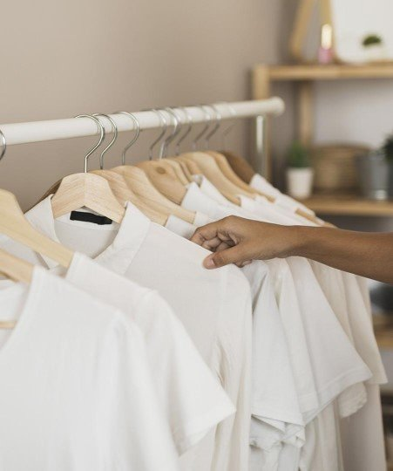
Dataset
It is a Women’s Clothing E-Commerce dataset revolving around the reviews written by customer
It has 23,486 columns and 11 rows
Features: Clothing ID, Age, Review Text, Title, Rating, Recommended IND, Positive Feedback Count, Division Name, Department Name, Class Nam

Slide 5



Mythology
Text Preprocessing
Topic Modeling
Gathering Data
EDA

Slide 6
Text Preprocessing
Clean Text
Remove: punctuation, lowercasing, non-alphabetic, stop words
Tokenize
Count Vector
TFIDF
Split Data
80% Train
20% Test

Slide 7
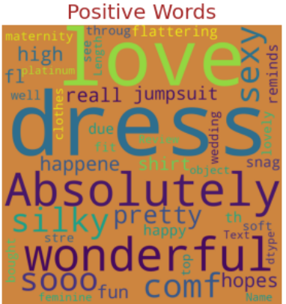
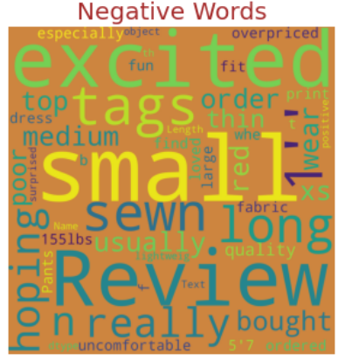
EDA

Slide 8
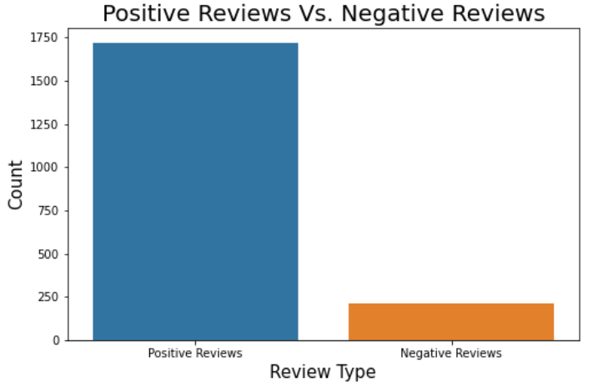
EDA

Slide 9
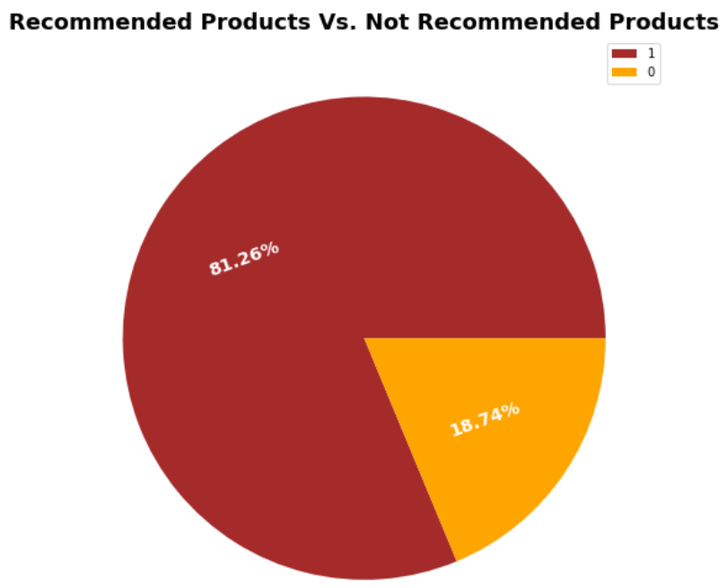
EDA

Slide 10
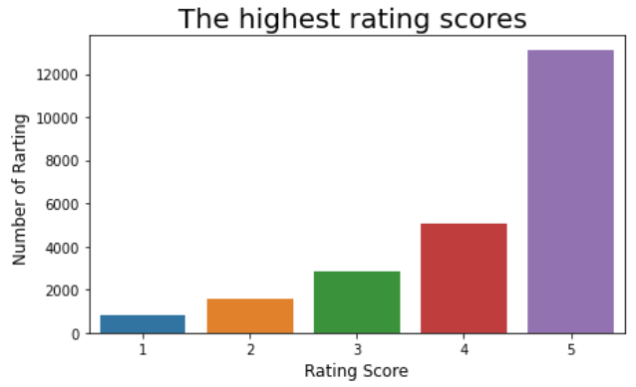
EDA

Slide 11
Topic Modeling
LSA Model
NMF Model
LDA Model

Slide 12
Results and Analysis

Slide 13

Conclusion
Best model LDA
Based on the results, women usually prefer Business Formal Attire, Casual Wear, Followed by Formal Wear On this basis, we prefer to choose these types of clothes to start our project.
future work …

